Slide 1
PhD Application Report
My Academic Journey and Future Aspirations
Lingyu Gong
Trinity College Dublin
Date 25/09/2024
Notes:
Hello, good afternoon, it’s an honor to share this pre with all of you. My name is Lingyu Gong, from Trinity College Dublin.

Slide 2


Contents
Self-Introduction
Project Overview
Future Plan
Notes:
My presentation is divided into three main parts:
Self-Intro
Selected Project Overview
Future Plan

Slide 3
Self-Introduction
1. Basic Information:
Undergraduate:
Capital Normal University
GPA:3.51/5.0
Major: Computer Science and technology
Postgraduate:
Trinity College Dublin
GPA: 66/100
Major: Electronic Information and Engineering
2. Project Experience:
Design & Research of a 3D Modeling Course (Leader).
Exploring Solutions for Data Restoration Using Protection Cards.
Research on Open Source Network-on-Chip (NoC) Based on Intelligent Routing Algorithm.
Enhancing NoC Network Predictions with Advanced AI Techniques.
3. Intern/ Working Experiences:
Trainee IT Teacher, Capital Normal University High School, 2022
Visiting Student, Chinese Academy of Sciences, 2022-2023
Part-time Bartender, The Auld Dubliner, 2023-2024
4. Student Work:
Beijing Winter Olympics Volunteer Regional Chief, 2022
President of the Student Union, 2020-2023
5. Selected Awards:
Title of Outstanding Graduation Thesis, 2023
Beijing Merit Student, 2021-2022
University-level Merit Student, 2021-2022
Major First Class Scholarship, 2020-2023
Major 2nd Class Scholarship, 2019-2020
Irish Badminton Cup/ League/ Intervarsity's Champions, 2023-2024
Notes:
My name is Lingyu Gong, and I graduated from Capital Normal University with a degree in Computer Science and Technology, achieving a GPA of 3.51. Later, I pursued a Master's degree in Electronic Information and Engineering at Trinity College Dublin, where I received a grade of 66.
In terms of academic experience, I’ve led several significant projects. As an undergraduate, I led the design and research of a 3D modeling course, which won first prize in a Laboratory Fund Project. I also contributed to the research on a data recovery protection card solution, which earned third prize in the same competition. My undergraduate thesis, in collaboration with a professor from the Chinese Academy of Sciences, focused on intelligent routing algorithms for open-source Network-on-Chip (NoC) systems and was recognized as an outstanding thesis. Building on this foundation, my master's project further advanced NoC network predictions using AI techniques.
I prioritize the combination of theory and practice. During my undergraduate studies, I taught C++ programming as a trainee IT teacher at Capital Normal University’s affiliated middle school. Additionally, I was honored to be a visiting student at the Chinese Academy of Sciences, where I worked on a GPU project, specifically focusing on NoC design. Last year, I worked part-time in a well-known pub in Dublin to better immerse myself in local culture. This experience not only improved my communication skills but also helped me make new friends, showcasing my adaptability.
My achievements have been widely recognized. I received the Outstanding Thesis award in 2023 and won several first-class scholarships. I also actively participated in extracurricular activities, serving as a volunteer leader for the Beijing Winter Olympics and as the President of the Student Union for three consecutive years. Furthermore, my badminton skills helped me secure championships in several Irish badminton leagues.

Slide 4
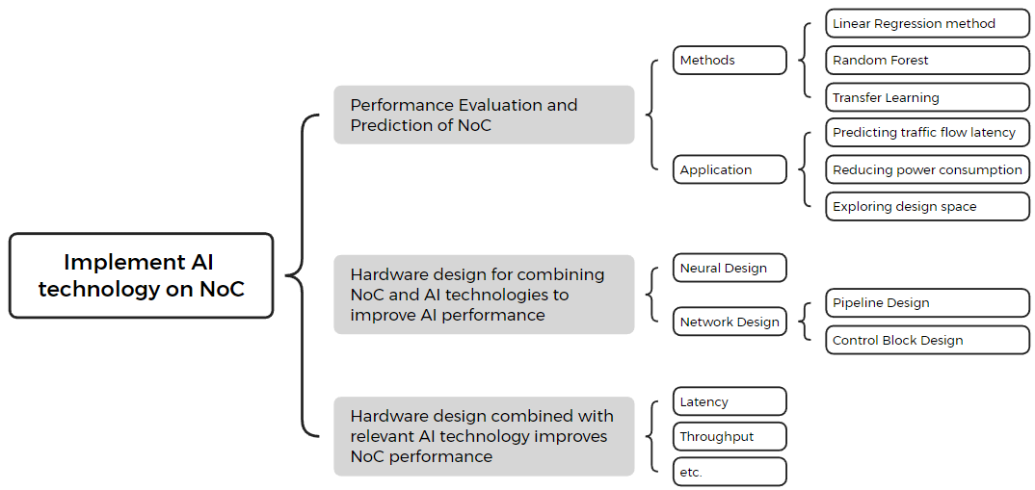
Selected Project Details
Fig 1: Classification of studies related to the combination of AI and NoC
ENHANCING ON-CHIP NETWORK PREDICTIONS WITH ADVANCED AI TECHNIQUES
Notes:
Now, it’s time to talk about my project finished during my master program.
For my master's project, the topic selection process was challenging. I started by reviewing five years of research articles on the intersection of NoC and AI. From my review, I identified three main research directions shows in Figure 1:
1. Implementing AI technology on NoC.
2. Using AI to evaluate and predict NoC parameters to enhance hardware performance.
3. Leveraging NoC’s scalability to accelerate AI applications and improve performance metrics like throughput and latency.
After discussing with my advisor and considering feasibility and time constraints, we chose to focus on implementing AI in NoC. Despite some delays in finalizing the topic, my main objective was to surpass the prediction accuracy of reference papers, which ultimately shaped the project's direction and title.

Slide 5
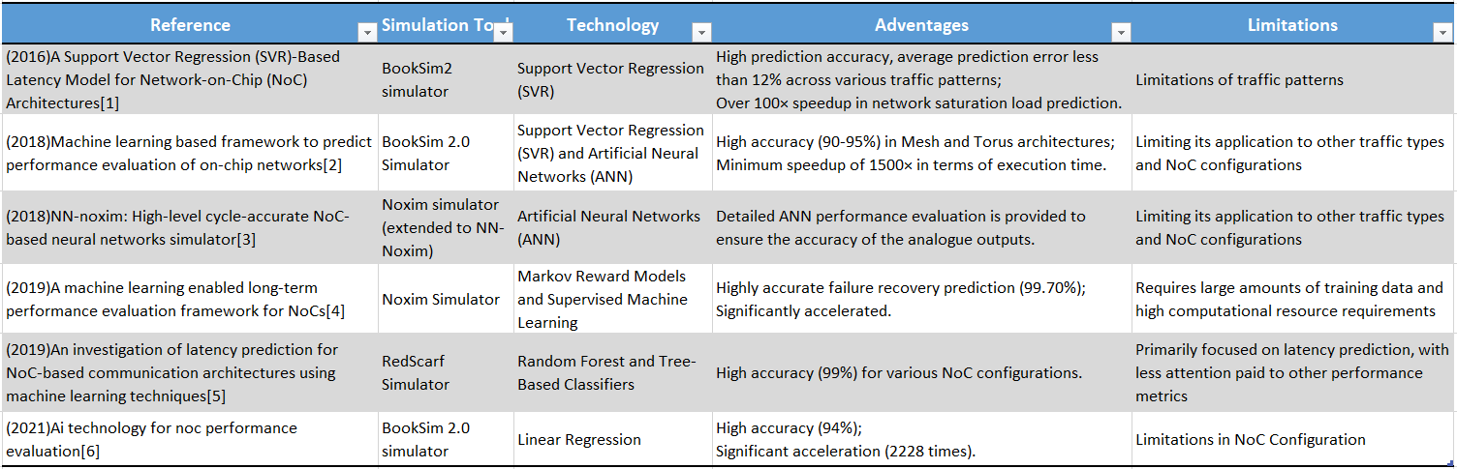
Existing technologies and Limitations
Advantages:
Achievement of high prediction accuracy (95%)
Significantly increase the speed of prediction
Limitations:
Limited to specific NoC configurations
High demand for computing resources
[1] Qian Z L, Juan D C, Bogdan P, et al. A support vector regression (SVR)-based latency model for network-on-chip (NoC) architectures[J]. IEEE Transactions on Computer-Aided Design of Integrated Circuits and Systems, 2015, 35(3): 471-484.
[2] Kumar A, Talawar B. Machine learning based framework to predict performance evaluation of on-chip networks[C]//2018 Eleventh International Conference on Contemporary Computing (IC3). IEEE, 2018: 1-6.
[3] Chen K C, Wang T Y. NN-noxim: High-level cycle-accurate NoC-based neural networks simulator[C]//2018 11th International workshop on network on chip architectures (NoCArc). IEEE, 2018: 1-5.
[4] Hou J, Han Q, Radetzki M. A machine learning enabled long-term performance evaluation framework for NoCs[C]//2019 IEEE 13th International Symposium on Embedded Multicore/Many-core Systems-on-Chip (MCSoC). IEEE, 2019: 164-171.
[5] Silva J, Kreutz M, Pereira M, et al. An investigation of latency prediction for NoC-based communication architectures using machine learning techniques[J]. The Journal of Supercomputing, 2019, 75(11): 7573-7591.
[6] Bhowmik B, Hazarika P, Kale P, et al. Ai technology for noc performance evaluation[J]. IEEE Transactions on Circuits and Systems II: Express Briefs, 2021, 68(12): 3483-3487.
Notes:
After finalizing the project direction, I conducted a literature review. I summarized previous works in a table, outlining the references, simulation tools, and AI technologies used. While previous works achieved high accuracy in predicting specific NoC parameters, they were often limited to specific NoC configurations and required significant computing resources. My project aimed to use a lightweight model to achieve higher prediction accuracy while including more evaluation indicators.
For simulations, I used BookSim2, a robust NoC simulator. It supports various network topologies, routing algorithms, and traffic patterns, allowing for large-scale network simulations. Users can customize parameters like traffic patterns and buffer sizes. BookSim2 was chosen because of its flexibility and wide usage in previous research.

Slide 6
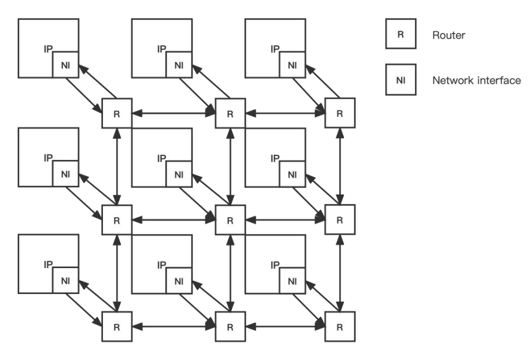
Network-on-Chip Overview
Network-on-Chip (NoC): integrated circuits designed for network-based communication subsystems
Consists of multiple sections of links and routers
The Network Interface (NI) module converts data packets from various IP blocks for transmission across the network
Scalability, High Performance, Low Latency, Power Efficiency, Design Flexibility
Fig 2: NoC structure diagram
Notes:
Before going further, Network-on-Chip (NoC), the key concept in this project, is a crucial communication subsystem integrated into chips. It’s used primarily in system-on-chip designs. NoC comprises wires and routers arranged in a grid layout, and its network interface converts data packets from various IP blocks for efficient transmission. NoC’s scalability, high performance, low latency, power efficiency, and design flexibility drive its continuous development.

Slide 7
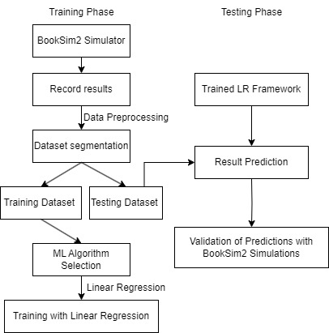
Prediction Framework
Figure 3 outlines the process used to develop the proposed predictive framework.
1. Training Phase:
BookSim2 Simulation: Generate data.
Record Results: Collect performance metrics from simulations.
Data Preprocessing: Clean and preprocess the collected data.
Dataset Segmentation: Split the data
ML Algorithm Selection: Choose a machine learning algorithm.
Linear Regression Training: Train the model.
2. Testing Phase:
Trained LR Framework: Utilize the trained linear regression model.
Result Evaluation: Validate predictions against new simulations.
Validation: Predicted results vs Actual simulation outcomes
Fig 3: Proposed LR Framework
Notes:
Back to the whole project, Figure 3 outlines the prediction framework of my project, divided into Training and Testing Phases. The Training Phase involves generating data using BookSim2, recording results, data preprocessing, segmenting the dataset, selecting an AI algorithm, and training the model using linear regression. The Testing Phase involves utilizing the trained linear regression model, validating predictions against new simulations, and evaluating the results.

Slide 8
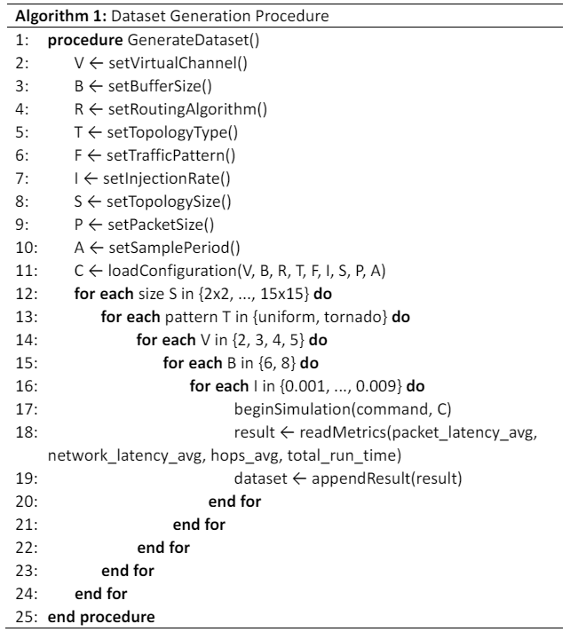
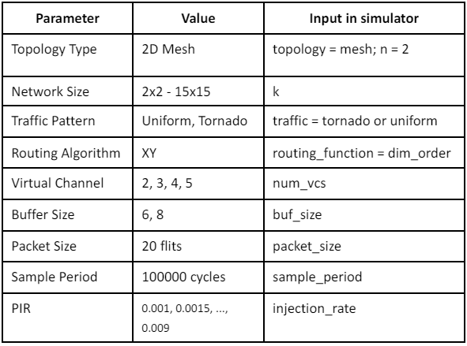
Data preparation
Dataset generation
Figure 4 shows the configuration details
Figure 5 is the process for dataset generation
Fig 4: The configuration details
Fig 5: Algorithm for dataset generation
Notes:
For dataset preparation, I used BookSim2 to generate the required data. Figure 4 shows the configuration details, and Figure 5 illustrates the pseudocode for dataset generation.

Slide 9
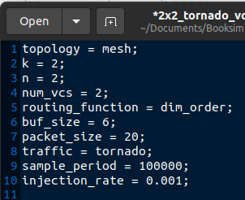
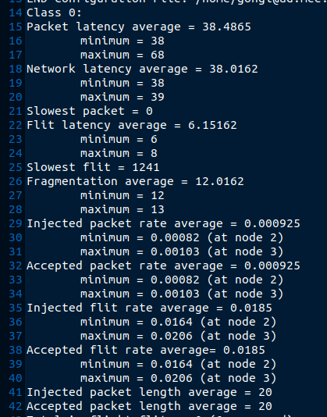
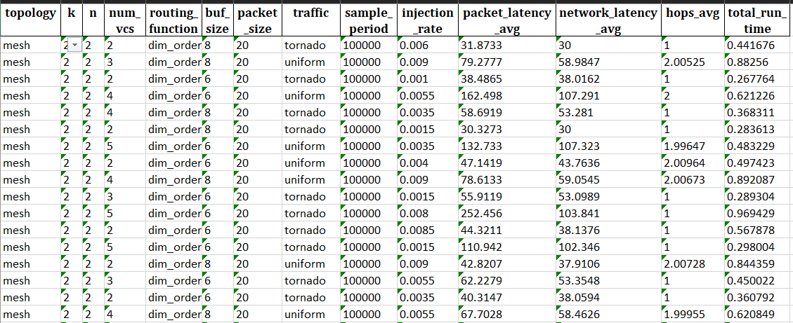
Data generation
This page shows the detailed results achieved from the simulations.
Figure 6 illustrates an example of a configuration file used in one of the simulations.
Figure 7 provides an example of a result file
Figure 8 shows part of the dataset abstracted from all the result files
Fig 6: Example of a configuration file
Fig 8: Part of datasets
Fig 7: Example of a result file
Notes:
Figures 6, 7, and 8 present examples of a configuration file, a result file, and part of the dataset abstracted from the result files, respectively.

Slide 10
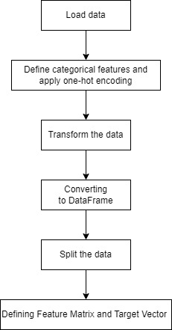
Data preparation
Data preprocessing:
Loading Data
Read dataset from Excel file
Check data types
Defining and Encoding Categorical Columns
Identify categorical columns (topology, routing function, traffic patterns)
Convert categorical data using One-Hot Encoding
Applying Column Transformer
Apply One-Hot Encoding to categorical columns
Keep numerical columns unchanged
Converting to DataFrame
Convert processed data to Pandas DataFrame
Verify encoded data types
Data Splitting
Split dataset into training and testing sets based on remainder__k value
Defining Feature Matrix and Target Vector
Feature Matrix (X): All columns except prediction targets
Target Vector (y): NoC performance parameters to be predicted
Fig 9: Process of data preprocessing
Notes:
Data preprocessing is crucial for the training phase. I have summarized this process in a flow chart and described the steps in detail. These steps include loading data, checking data types, applying one-hot encoding to categorical data, converting the data into a Pandas DataFrame, splitting the dataset into training and testing sets, and defining the feature matrix and target vector.

Slide 11
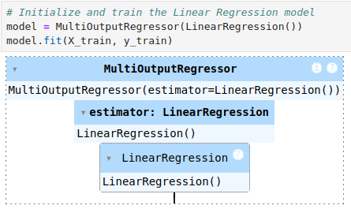
AI Model Selection and Training
1. Model Selection
Linear Regression[1]:
Chosen for its simplicity and interpretability
Suitable for predicting continuous numerical values
2. Model Initialization and Training
MultiOutputRegressor with Linear Regression:
Handles multiple target variables simultaneously
Uses Linear Regression for each target variable
Fig 10: Linear Regression Training Model
[1] Bhowmik B, Hazarika P, Kale P, et al. Ai technology for noc performance evaluation[J]. IEEE Transactions on Circuits and Systems II: Express Briefs, 2021, 68(12): 3483-3487.
Notes:
For AI model selection and training, I chose linear regression due to its simplicity and interpretability, making it suitable for predicting continuous values. I used a MultiOutputRegressor with linear regression to handle multiple target variables simultaneously.

Slide 12


Model Evaluation Metrics
1. Mean Squared Error (MSE)
Definition: Measures the average squared difference between actual and predicted values.
Formula:
Purpose: Indicates how close the predictions are to the actual values; lower values signify better model performance.
2. Variance
Definition: Measures the spread of the data points.
Formula:
Purpose: Indicates the extent to which data points differ from the mean value; used to assess the error’s variability.
3. Accuracy
Definition: A measure of how close the predictions are to the actual values, often defined in various ways depending on context.
Formula:
Purpose: Provides a normalized measure of prediction quality; values closer to 1 imply higher accuracy.
Notes:
Model evaluation metrics include Mean Squared Error (MSE), R-squared (R²), Variance, and Accuracy. These metrics help assess the quality of my model. The formulas for these metrics are well-known in deep learning evaluation, so I will skip the details here.

Slide 13
Model Visualization
Actual vs. Predicted Values:
Line plots showing the comparison.
Present a comprehensive visualization comparing the actual values with the predicted values for four different NoC (Network-on-Chip) performance metrics. Each subplot corresponds to a different performance metric, allowing for a clear and detailed comparison.
Error Distribution:
Histograms of errors for each target variable.
Visualize the distribution of prediction errors for four different NoC (Network-on-Chip) performance metrics. These histograms provide insights into the accuracy and reliability of the model's predictions by showing how the errors are distributed.
Notes:
For model visualization, I used line plots to compare actual and predicted values for different NoC performance metrics and histograms to analyze error distribution.

Slide 14
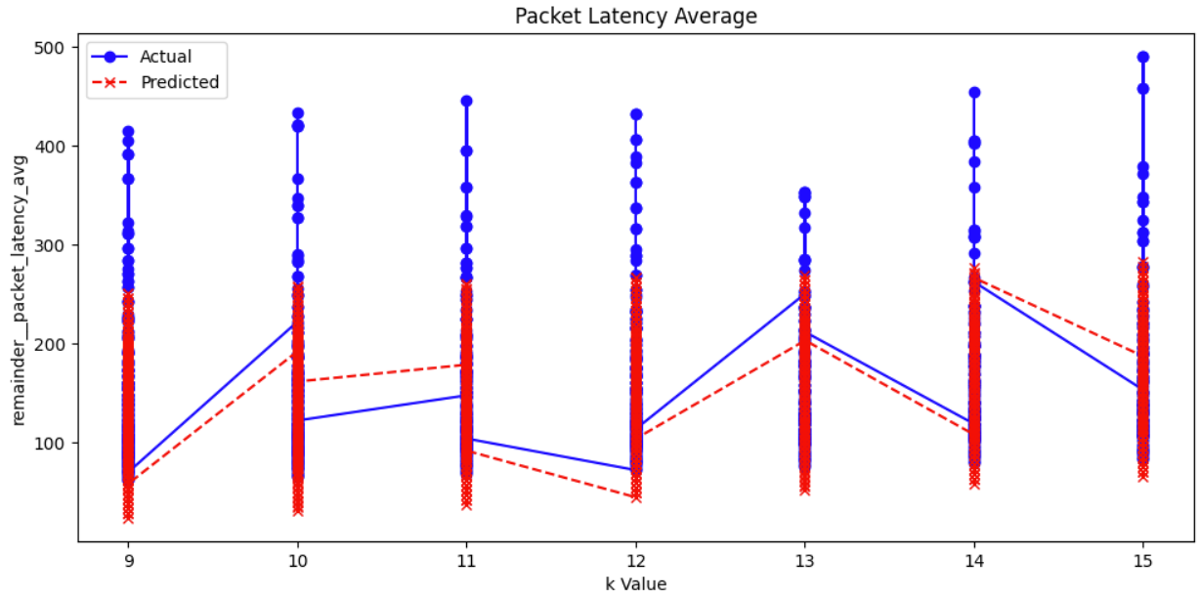
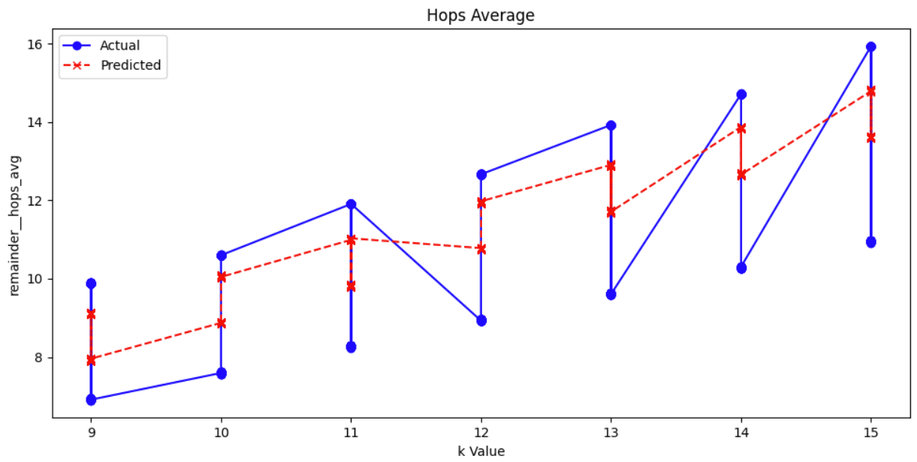
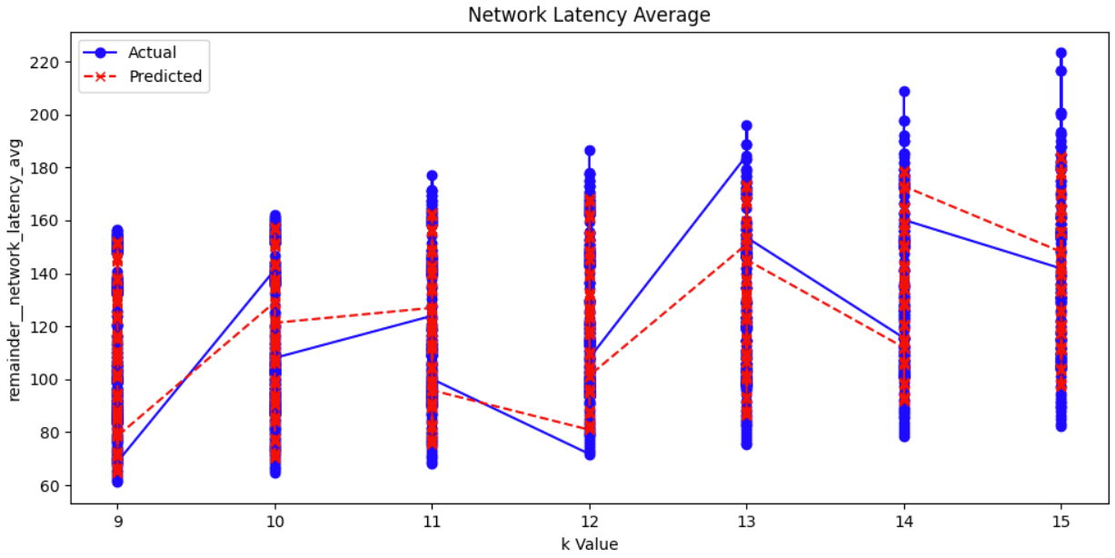
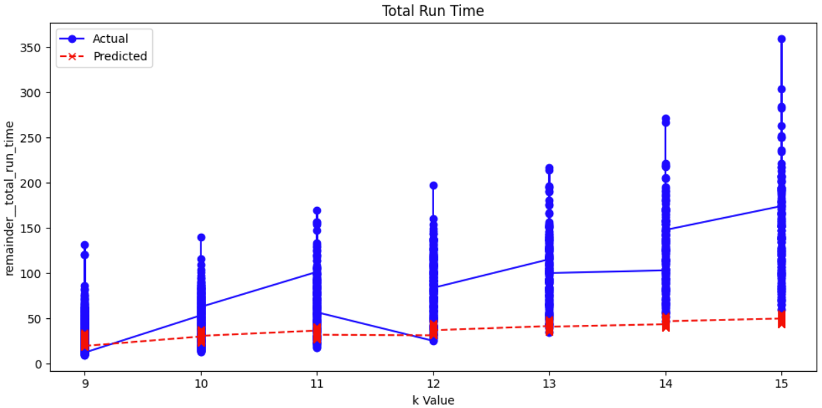
Projected results
Notes:
These four graphs display the trends of Packet Latency, Network Latency, Hops, and Total Run Time with different k values. Blue dots represent actual values, while red crosses represent predicted values. The connecting lines are based on the average values at each k value, showing the overall trend.
The model’s predictions for Packet Latency and Network Latency are close to the actual values, especially for Network Latency, where predictions are highly accurate.
However, for Hops, there’s a noticeable discrepancy between predicted and actual values, particularly at higher k values, indicating room for improvement.
For Total Run Time, the model predicts faster results than the simulator, highlighting its efficiency in reducing computational time.
In summary, while Hops predictions need improvement, the model performs well for latency metrics and significantly boosts computational speed.

Slide 15
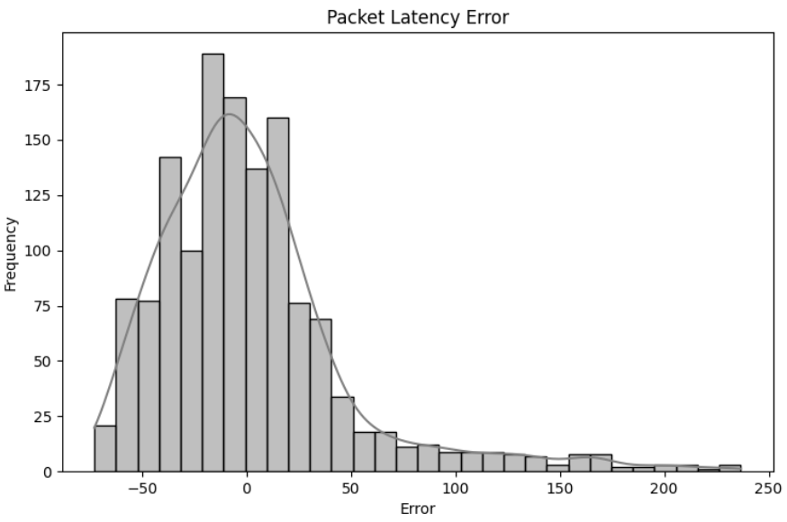
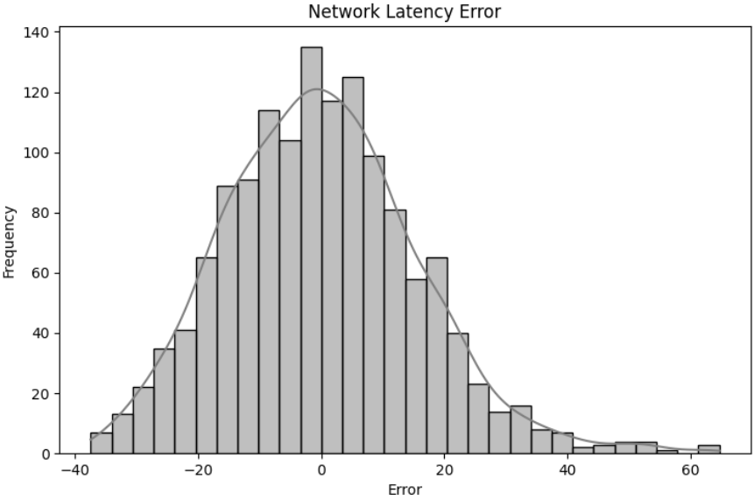
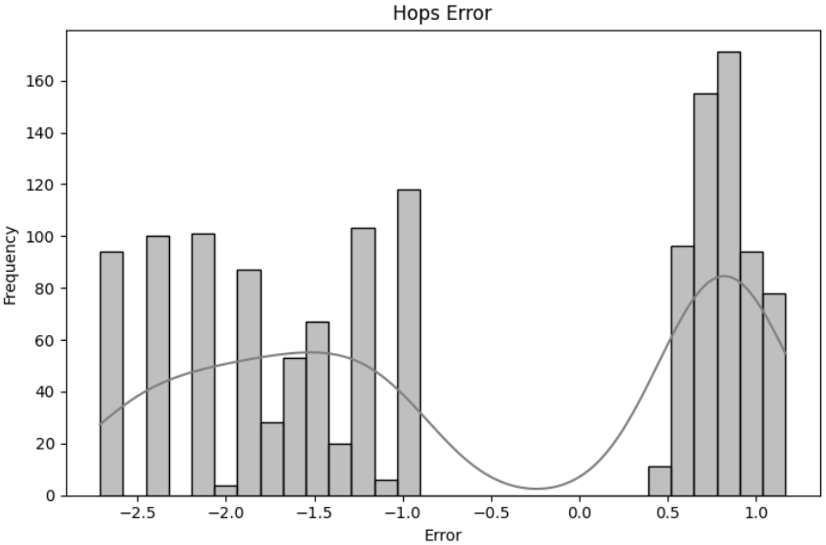
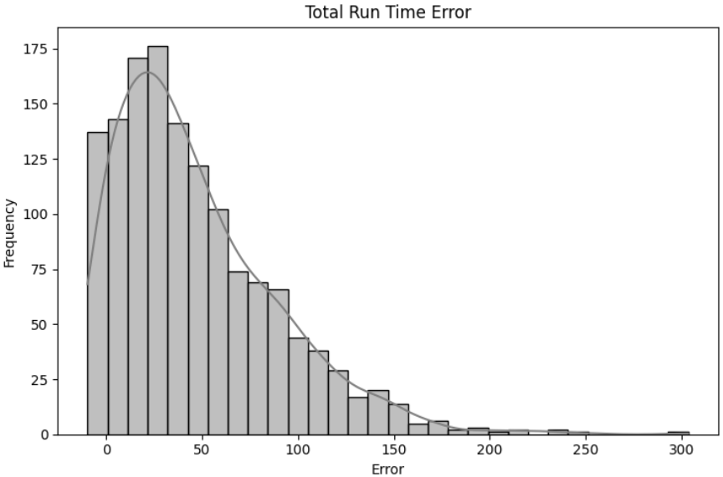
Error Analysis
Notes:
The error distribution analysis reveals that for packet delay, network delay, and time, most prediction errors are concentrated around zero, indicating high accuracy. However, for hop count, the errors are more dispersed, indicating some inaccuracy in predictions.

Slide 16
Summary of results achieved
Overall, the model achieves high accuracy levels across most metrics, particularly excelling in network latency predictions. However, there is potential for improvement in predicting hops and total run time to achieve even better performance.
Metric | Packet Latency | Network Latency | Hops | Total Run Time
MSE | 2202.17 | 244.83 | 2.24 | 3981.82
Variance | 5264.54 | 960.24 | 5.89 | 2454.33
Accuracy | 0.99 | 0.98 | 0.75 | 0.97
Table 1: Summary of assessment metrics
Notes:
In summary, the results show high accuracy levels across most metrics, particularly excelling in network latency predictions. However, there is room for improvement in predicting hops and total run time. I will continue to work on these aspects to achieve better performance.

Slide 17
Challenges and Responses
Learning the NoC Network Configuration
Challenge: Booksim2 simulator, steep learning curve
Response: Documentation, tutorials, practice simulations
Long Simulation Run Time
Challenge: 4 days per simulation round, inefficiency
Response: Optimize parameters, parallel processing
Problems with Data Collection and Integration
Challenge: Data integration issues, organization
Response: Python scripts, automation, Excel formatting
AI Model Application and Validation
Challenge: New data application, validation vs. literature
Response: Thorough testing, benchmark comparison, fine-tuning
Notes:
Throughout the project, I encountered several challenges. Learning to configure the NoC network using BookSim2 was difficult due to its steep learning curve. My solution was to study the official documentation and practice simulations. The long simulation run time, taking about four days per round, was inefficient. I optimized parameters and used parallel processing to address this. Data collection and integration posed challenges, which I overcame by using Python scripts for automation and Excel for data formatting. Finally, applying and validating the AI model required thorough testing, benchmarking comparisons, and careful fine-tuning to ensure accuracy and reliability.

Slide 18
Future Plan
Finish my PhD Study
Focus on deep research in my field.
Build a strong research portfolio with publications.
Explore Industry
Apply academic knowledge in open-source FPGA.
Identify breakthrough opportunities in various industries (AI hardware, telecommunications, etc.).
Continue Learning
Address challenges in data integration and system design.
Enhance skills in Python, automation, and FPGA design tools.
Notes:
My future plans focus on three key areas:
First, I aim to complete my PhD. My primary goal is to conduct in-depth research and develop comprehensive expertise in my field. I want to advance my work, contribute meaningful insights, and have a significant impact on the academic community. Throughout my PhD, I plan to publish high-quality papers, participate in international conferences, and collaborate with leading experts to continually refine and enhance my research.
Next, I plan to transition into the technology industry. After completing my PhD, I intend to apply my academic knowledge, especially the technologies related to FPGAs, to real-world problems. While I haven't identified a specific industry yet, I'm exploring opportunities in areas such as telecoms, AI hardware acceleration and embedded systems - where FPGAs can have a significant impact. My goal is to use what I've learnt to discover breakthrough innovations and advance technology.
Finally, I plan to continue learning. As I discover breakthrough opportunities, I expect to face new challenges that will require further learning and experimentation. I want to maintain a mindset of continuous learning while staying grounded in applying theoretical knowledge to practical solutions. To achieve this, I will keep improving my technical skills, such as mastering Python scripting, automation, and FPGA design tools. This ongoing learning will ensure I stay competitive and adaptable to future demands in both academic and industry environments.

Slide 19
Thank You
Notes:
Thank you for your attention. I look forward to your questions and feedback.

